Slide 1
Boost the Search using Apache Solr
View Apache Solr course details at www.edureka.co/apache-solr
For Queries during the session and class recording:
Post on Twitter @edurekaIN: #askEdureka
Post on Facebook /edurekaIN
For more details please contact us:
US : 1800 275 9730 (toll free)
INDIA : +91 88808 62004
Email Us : sales@edureka.co

Slide 2
How it Works?

Slide 3
Objectives
At the end of this module, you will be able to understand:
The need for search engine for enterprise grade applications
The objectives & challenges of search engine
What is Indexing & Searching & Why do you need them?
How is Indexing & Searching Handled in Lucene
What is Solr & its features?
What is Solr schema & its structure?
How to achieve Bigdata/NoSQL needs using SolrCloud
Leveraging Solr Capabilities with Hadoop
About job opportunity for Solr Developers

Slide 4
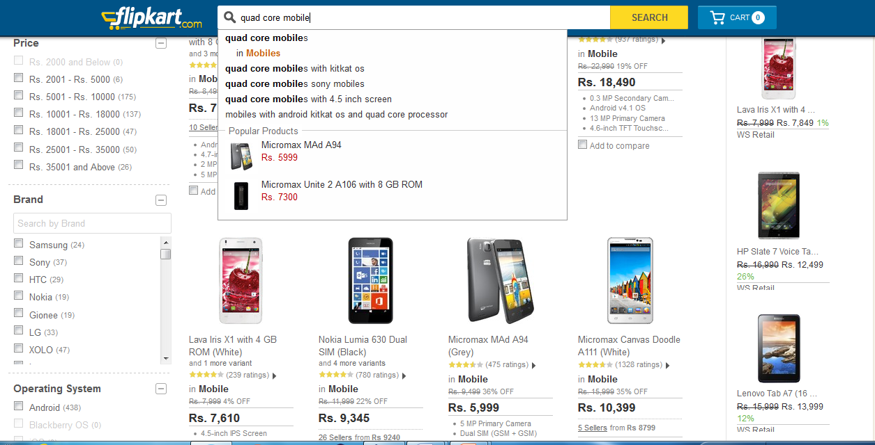
Why Do I Need Search Engines ?

Slide 5
Search Engine: Why do I need them?
1
2
1. Text Based Search
2. Filter
3. Documents
3

Slide 6
Search Engine – What it should be?
If you need a storage engine to search records / documents using text-based keywords it should support following features:
Should be optimized for faster text searches
Should have flexible schema
Should support sorting of documents
Web Scale - Should be optimized for reads
Should be document oriented

Slide 7
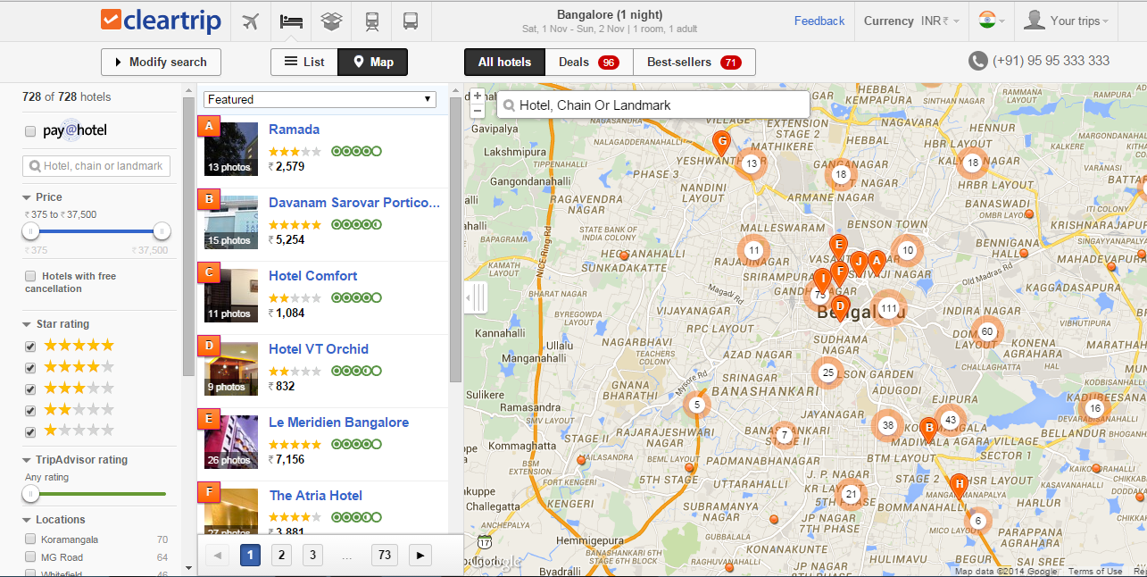
Cleartrip Spatial Search

Slide 8


What is Lucene ?
Lucene is a powerful Java search library that lets you easily add search or Information Retrieval (IR) to applications
Used by LinkedIn, Twitter, … and many more (see http://wiki.apache.org/lucene-java/PoweredBy )
Scalable & High-performance Indexing
Powerful, Accurate and Efficient Search Algorithms
Cross-Platform Solution
Open Source & 100% pure Java
Implementations in other programming languages available that are index-compatible
Doug Cutting “Creator”

Slide 9

Indexing – How it works?
Document - 1 (“D1”)
Document - 2 (“D2”)
Document - 3 (“D3”)
I like edureka courses
Edureka teaches big data courses
Edureka helps learn new technologies easily
“edureka” = {D1, D2, D3}
“courses” = {D1, D2}
“teaches” = {D2}
“big” = {D2}
“data” = {D2}
“helps” = {D3}
“edureka”

Slide 10
Lucene – Writing to Index
Document
Field
Field
Field
Field
Directory
Analyzer
IndexWriter
Classes used when indexing documents with Lucene

Slide 11
Lucene – Searching In Index
Query Parser translates a textual expression from the end into an arbitrarily complex query for searching
QueryParser
Query object
IndexSearcher
Expression
Text fragments
Analyzer

Slide 12
Scoring – Score Boosting
Document’s weight / score can be changed from default, which is called as boosting
Lucene allows influencing search results by "boosting" at different times:
Scoring
Index Time
Query Time
Index-time boost by calling Field.setBoost() before a document is added to the index
Query-time boost by setting a boost on a query clause, calling Query.setBoost()

Slide 13
A Search System
The first step of all search engines, is a concept called Indexing
Indexing is the processing of original data into a highly efficient cross-reference lookup in order to facilitate rapid searching
Analyze: Search engine does not index text directly. The text are broken into a series of individual atomic elements called tokens
Searching is the process of consulting the search index and retrieving the documents matching the query, sorted in the requested sort order
Index document
Analyze document
Search UI
Index
Build document
Build query
Render results
Acquire content
Run query

Slide 14
What is Solr ?
Solr is an open source enterprise search server / web application
Solr Uses the Lucene Search Library and extends it
Solr exposes lucene Java API’s as RESTful services
You put documents in it (called "indexing") via XML, JSON, CSV or binary over HTTP
You query it via HTTP GET and receive XML, JSON, CSV or binary results

Slide 15
Solr: Key Features
Advanced Full-Text Search Capabilities
Optimized for High Volume Web Traffic
Standards Based Open Interfaces - XML, JSON and HTTP
Comprehensive HTML Administration Interfaces
Server statistics exposed over JMX for monitoring
Near Real-time indexing and Adaptable with XML Configuration
Linearly scalable, auto index replication, auto, Extensible Plugin Architecture

Slide 16








Solr – Who is using it ?
For more information, go to: http://lucidworks.com/blog/who-uses-lucenesolr/

Slide 17
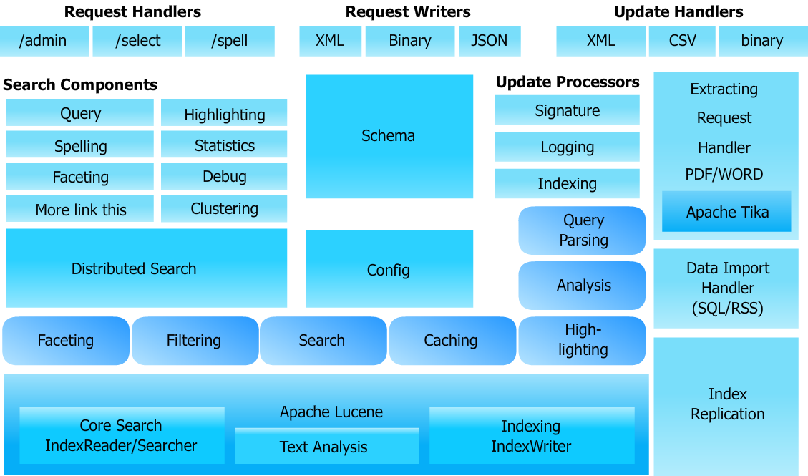
Solr: Architecture

Slide 18

Solr: Search Process
qt: selects a RequestHandler for a query using/select(by default, the DisMaxRequestHandler is used)
Request Handler
defType : selects a query parser for the query
(by default, uses whatever has been configured for the RequestHandler)
Response Writer
wt: selects a response writer for formatting the query response
Query Parser
qf: selects which fields to query
in the index(by default, all fields are required)
fq: filters query by applying an additional query to the initial query’s results, caches the results
 | Index
Rows: specifies the number of rows to be displayed at one time
Start: specifies an offset(by default 0) into the query results where the returned response should begin

Slide 19
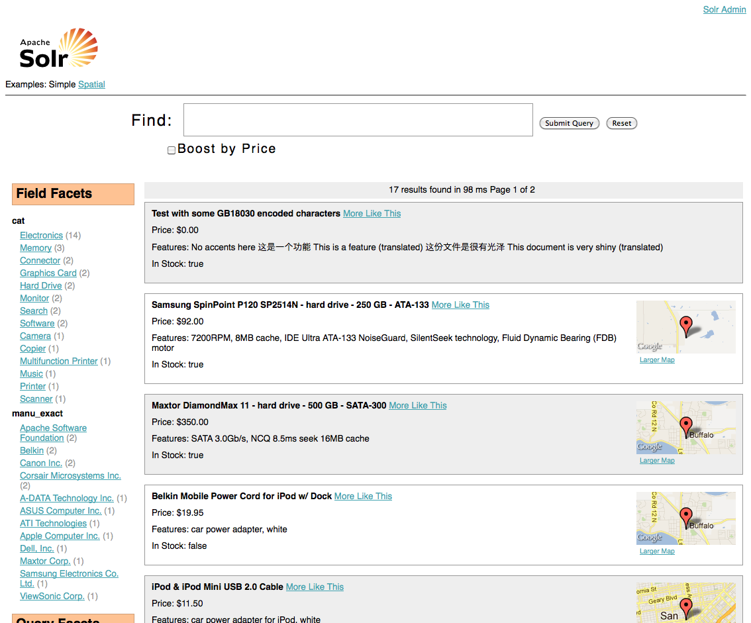
Velocity Search UI / Solritas
Solr includes a sample search UI based on the VelocityResponseWriter (also known as Solritas) that demonstrates several useful features, such as:
Searching
Faceting
Highlighting
Autocomplete
Geospatial searching
You can access the Velocity sample Search UI here:
http://localhost:8983/solr/browse

Slide 20
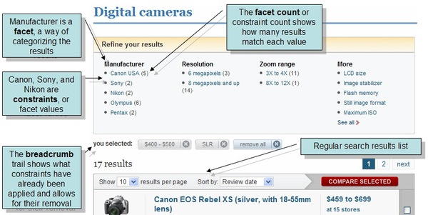
Faceting
Faceting is the arrangement of search results into categories based on indexed terms
Searchers are presented with the indexed terms, along with numerical counts of how many matching documents were found for each term
Faceting makes it easy for users to explore search results, narrowing in on exactly the results they are looking for

Slide 21
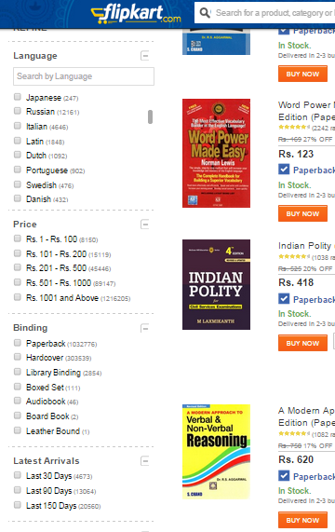
Faceting
A category is an aspect of indexed documents which can be used to classify the documents
For example, in a collection of books at an online bookstore, categories of a book can be its price, author, publication date, binding type, and so on

Slide 22
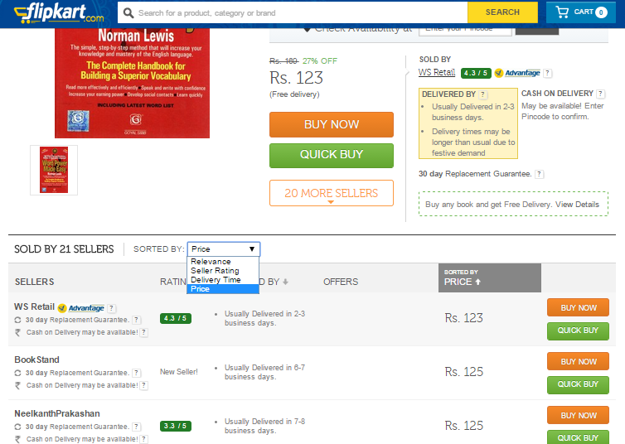
Faceting
In faceted search, in addition to the standard set of search results, we also get facet results, which are lists of subcategories for certain categories
For example, for the price facet, we get a list of relevant price ranges; for the author facet, we get a list of relevant authors; and so on. In most UIs, when users click one of these subcategories, the search is narrowed, or drilled down, and a new search limited to this subcategory (e.g., to a specific price range or author) is performed

Slide 23

Demo

Slide 24

SolrCloud
Apache Solr includes the ability to set up a cluster of Solr servers that combines fault tolerance and high availability called SolrCloud
SolrCloud is flexible distributed search and indexing, without a master node to allocate nodes, shards and replicas
Solr uses ZooKeeper to manage these locations, depending on configuration files and schemas
Documents can be sent to any server and ZooKeeper will figure it out

Slide 25
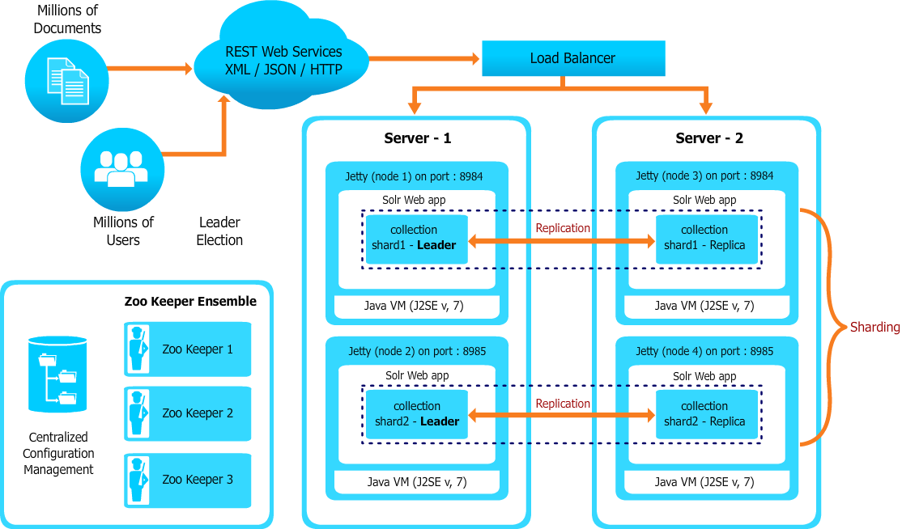
Architecture

Slide 26
Leveraging Solr Capabilities with Hadoop
Solr provides us fast, efficient, powerful full-text search and near real-time indexing and SolrCloud is flexible distributed search and indexing, and will do things like automatic fail over etc.
Hence its very suitable as NoSQL replacement for traditional databases in many situations, especially when the size of the data exceeds what is reasonable with a typical RDBMS
We can do scalable indexing using Hadoop MapReduce or PIG job and then load the indexed data in Solr
In all the major Hadoop distribution like Cloudera, Hortonworks, MapR you can integrate Solr easily

Slide 27


Scalable Indexing
Search Web App
HDFS
(Hadoop Distributed File System)
Query
Response
PDF
Raw Files
Word
SolR
SolR
SolR
HTML
. . .
Lucene
Input Data
Raw Files
Indexed
MapReduce Indexing Job

Slide 28
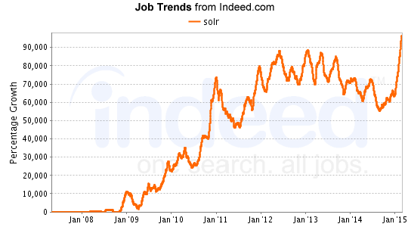
Job trends for Apache Solr

